Slide 1
Dynacare Insurance Solutions Order Tracker
User Guide

Slide 2
DIS Order Tracker Access
via iCare with one click

Slide 3
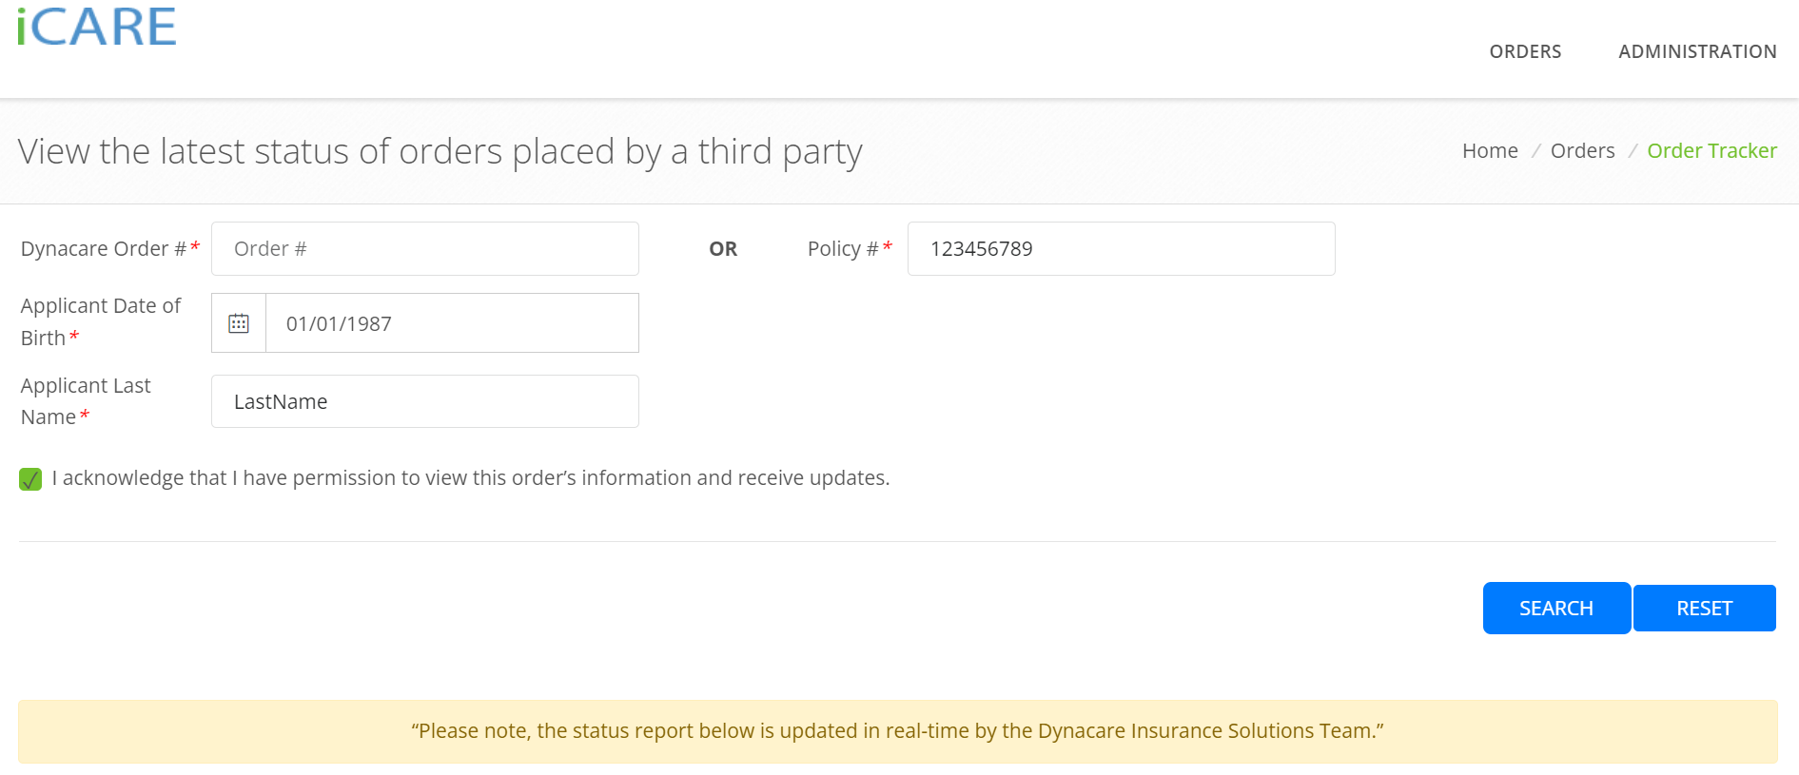
Order Status Updates
in Real Time
Advisors will be able to search for the most up to date status of an order by providing the following information:
iCare Order # OR Policy #
Applicants DOB AND Applicants Last Name

Slide 4
View Status of Orders
placed by a third party

Slide 5
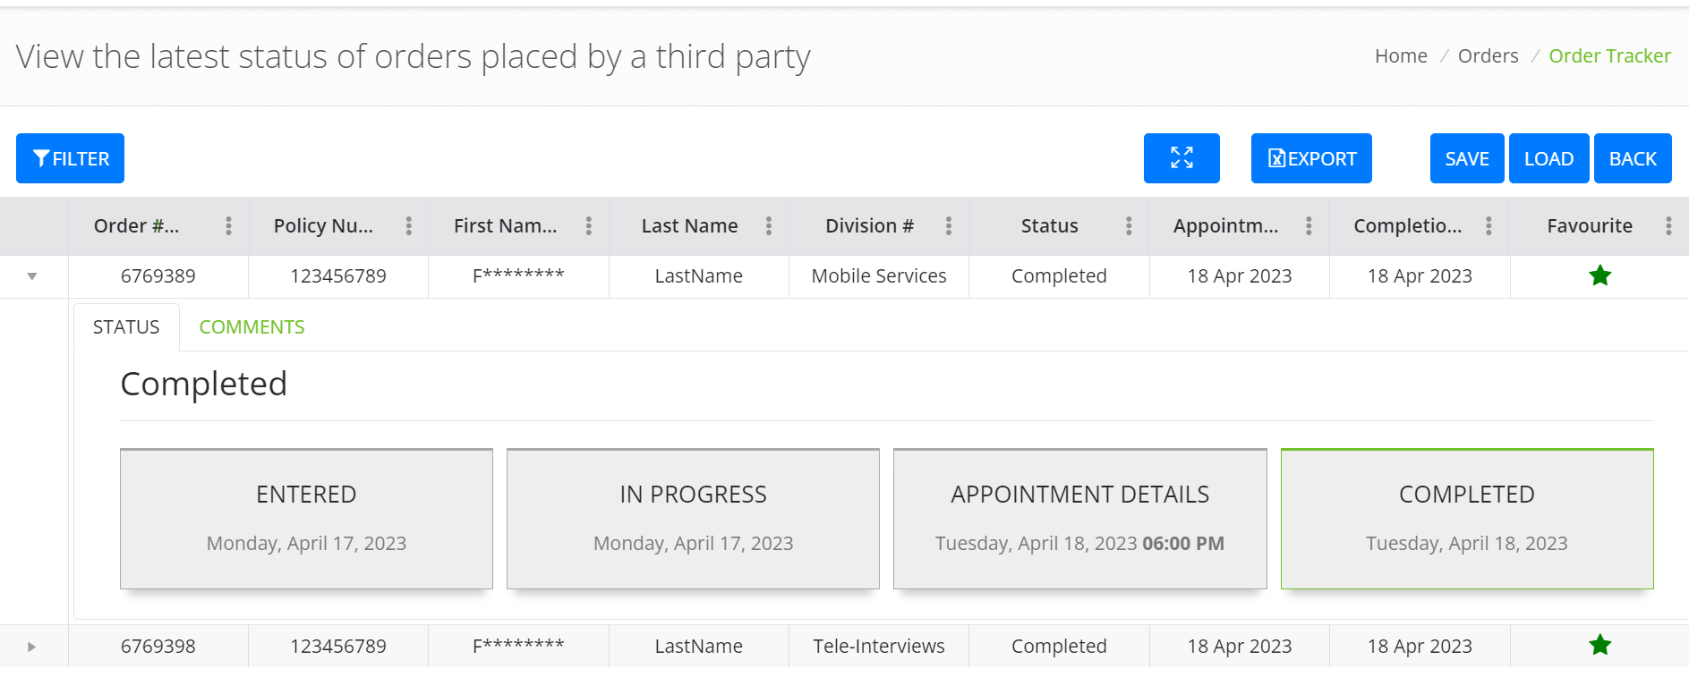
Click on The Arrow for An Expanded View
Order Status

Slide 6
Weekly Email Updates
for orders marked under your favorite list

Slide 7
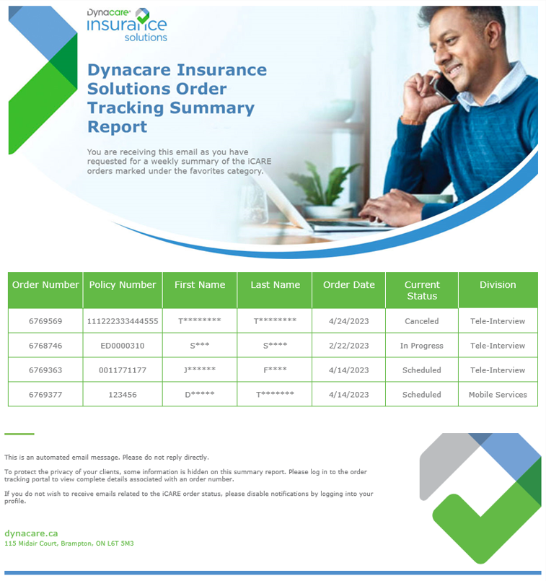
Order Tracking Summary Report
Email sample

Slide 8
Thank You!
Questions?

