Slide 1
Dynacare Insurance Solutions Scheduler
Launched January 9th, 2023

Slide 2
Booking your Telephone Interview is Easier than Before!
Dynacare has created an effortless appointment booking and management system to allow advisors and applicants to schedule their own telephone interview through a secure online portal.
By receiving the applicant’s email address and/or cell phone number, the advisor or applicant will be able to schedule, change or cancel their own appointments, at their own time!
To ensure an overall positive experience for the applicant, we encourage you to provide us with the applicant’s email and cellphone number when ordering the Tele-Interview.

Slide 3
What are the benefits of the DIS Scheduler
Advisor Benefits
Automated email notifications when the applicant's appointment has been scheduled or changed
Speed to access of appointments – advisors can book for the applicant
One SSO access through the iCARE ordering system – all advisors can have an iCARE profile
Applicant Benefits
Applicants self-manage their appointment and schedule
No telephone tag
Checklist of required documents provided prior to the call
Email or text message appointment reminders 24 hours and 1 hour before the appointment

Slide 4
FAQs
Why was the DIS Scheduler developed?
We want to be able to control our own lives by scheduling our own appointments when convenient. Several companies already offer online scheduling tools – i.e. massage therapy, dental appointments and restaurants. We want to remove callouts, telephone tag, have a better TAT and avoid no-shows.
When will the scheduler be launched?
Launched January 9th, 2023
Who can schedule the telephone interview?
Advisors and Applicants through the scheduling tool
Will there be a change to the ordering process?
No, there is no change to the ordering process.
Will there be a change to the delivery of the interview transcripts and recordings to the carrier?
No, there is no change to the delivery process.
What if an advisor does not have an iCare advisor profile to access the scheduler?
All advisors can create their advisor profile at https://orders.dynacare.ca/customer

Slide 5
FAQs
How does the advisor schedule the appointment on behalf of the applicant?
The advisor will log into the portal and provide certain identifiers (iCare number, policy/application number, DOB, name). If all the identifiers match the order received in iCare, the advisor will be able to schedule the appointment on behalf of the applicant.
How is the applicant notified their advisor scheduled an appointment on their behalf?
The applicant will receive an email with a link to click to confirm their appointment.
What if the applicant does not confirm the appointment?
Our interviewer will still contact the client during the scheduled timeframe to complete the interview.
What if the applicant is a no-show?
Our team will proceed with the standard problem file procedure and contact the applicant to reschedule the appointment or contact the carrier to advise of the delay.
What if we do not have the applicant’s email address?
A cell phone number could be as effective as we will send the applicant a text message with a link to the scheduling tool.

Slide 6
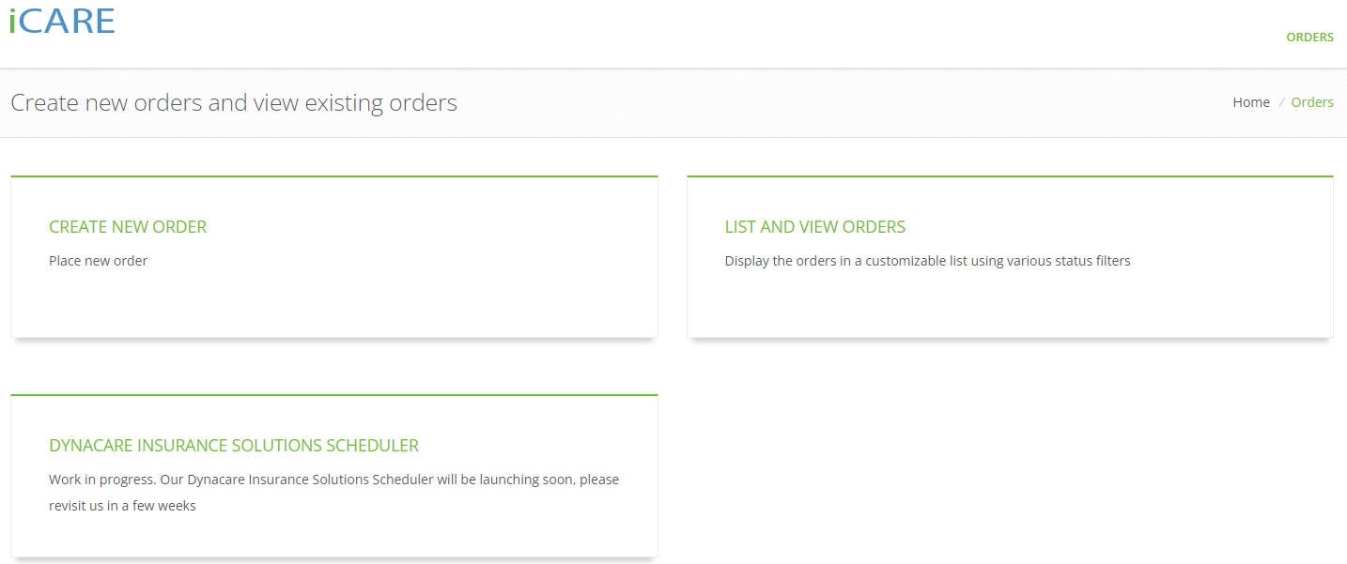
Advisors can access the DIS Scheduler from iCARE with one click

Slide 7
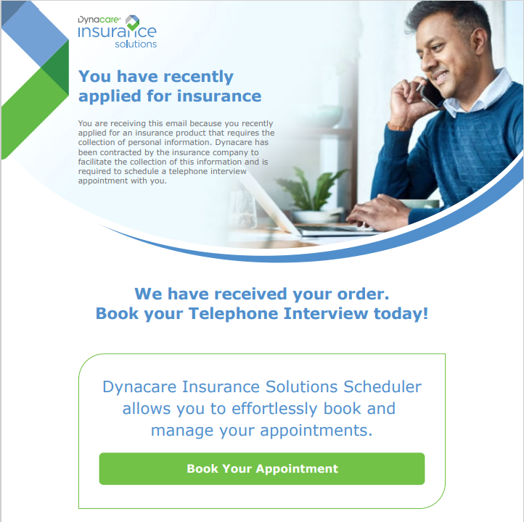
Applicants can access the DIS Scheduler by clicking the link in the email

Slide 8
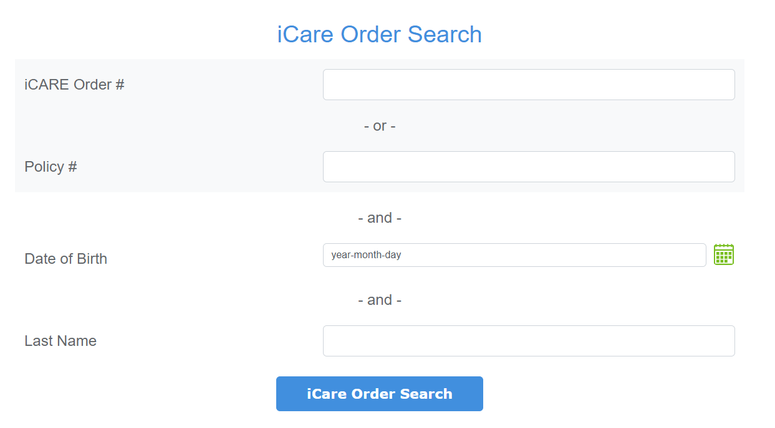
Once logged into iCARE, Advisor can search for the Tele-Interview Order in the iCARE system
Advisors will be able to search for the most up to date status of an order by providing the following information:
iCare Order # OR Policy #
Applicants DOB AND Applicants Last Name

Slide 9
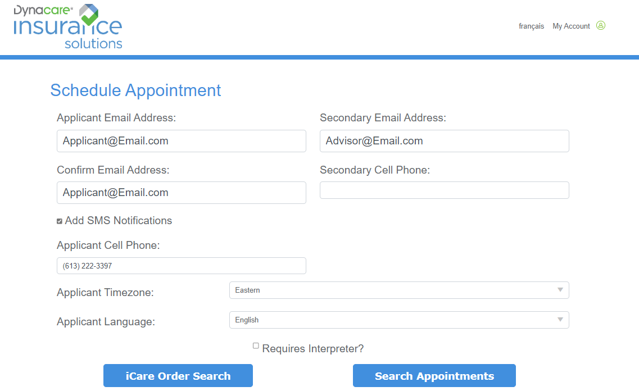
Scheduling the appointment

Slide 10
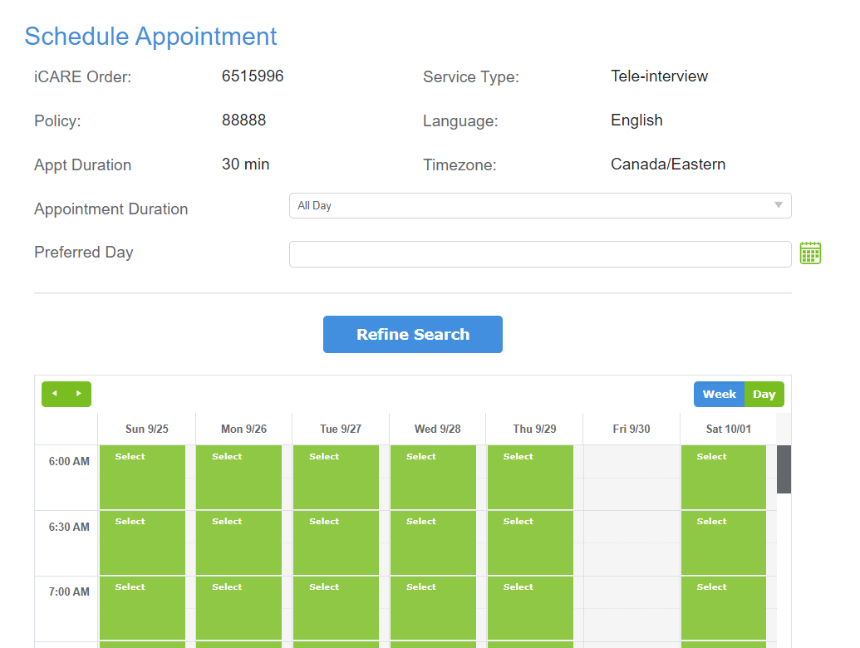
The advisor or Applicant will be able to select the appointment date and time by clicking on the Calendar.

Slide 11
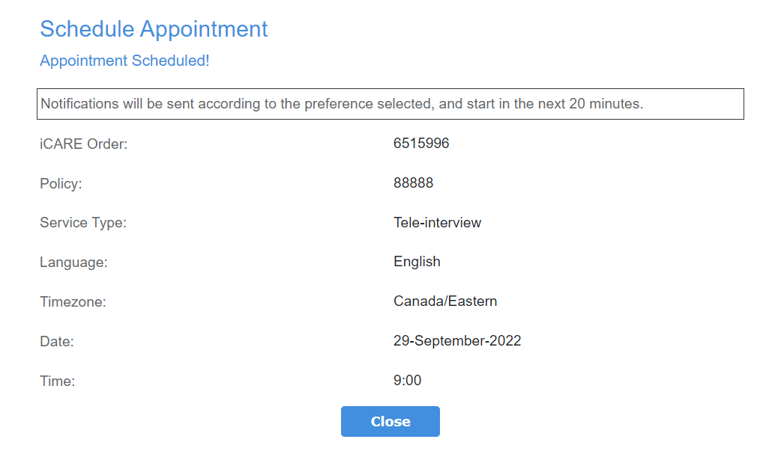
Once the appointment is scheduled, there will be a confirmation page with the appointment details.

Slide 12
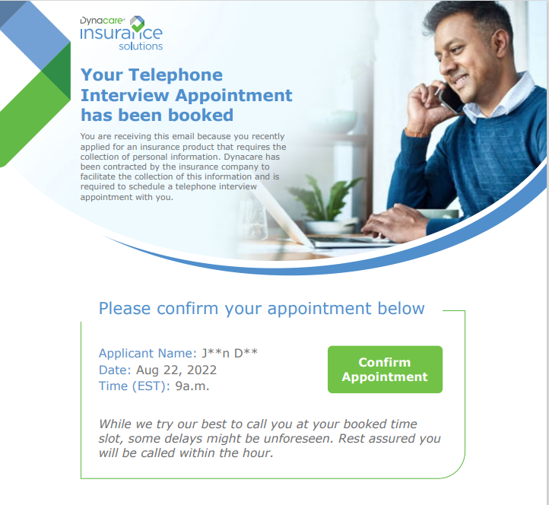
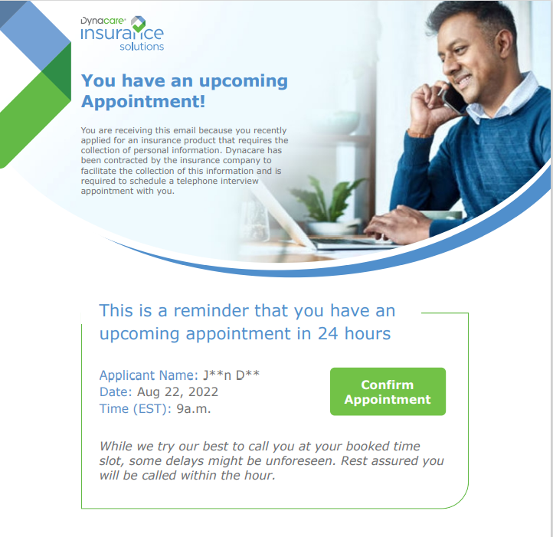
Sample Notifications the Applicant will receive

Slide 13
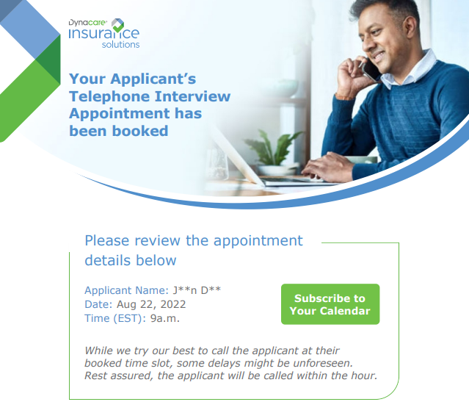
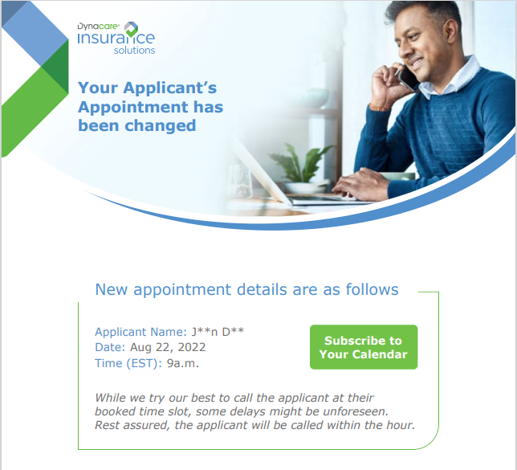
Sample Notifications the Advisor will receive

Slide 14
Both the applicant and advisor can receive email notifications
Applicant’s will receive email notifications when:
Dynacare has received the order
When the appointment has been confirmed
If the appointment has been changed or cancelled
Appointment reminder 24 hours before the scheduled appointment
Appointment reminder 1 hour before the scheduled appointment
Advisors will receive email notifications when:
When the appointment has been confirmed
If the appointment has been changed or cancelled

Slide 17
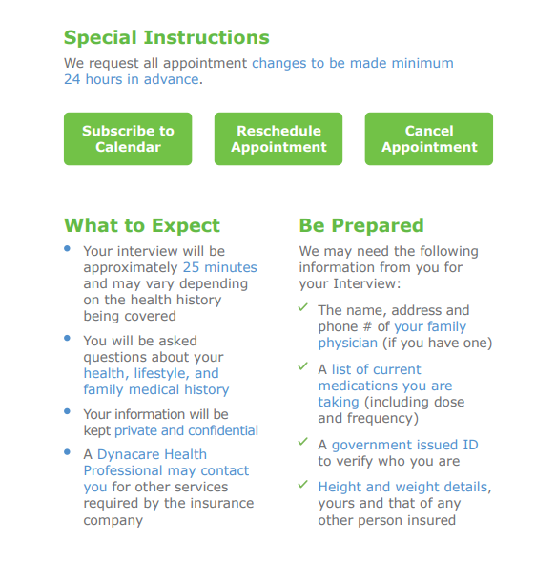
Applicant’s will be able to reschedule their appointment if needed and watch a preparation video to ensure a positive experience

Slide 18
How can you ensure maximum success?
Include the applicant’s email address and cell phone number in the appropriate fields when placing an order for a Tele-Interview
Once Dynacare has received the order for the Tele-Interview, the advisor can log in to schedule the appointment on behalf of their client to avoid any delays and a quick turn around time.

Slide 19
Thank You!
Questions?

